Slide 1
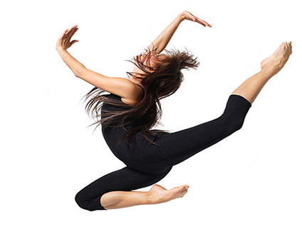
LESSON 2
YEAR 9 DANCE
DANCE SKILLS UNIT .
LESSON 2

Slide 2
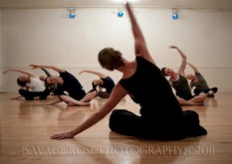

REVIEW OF LAST LESSON
.
Questions
What 3 things did you do well at?
What 3 things do you need to improve on?
How are you going to achieve this?

Slide 3

TARGET SETTING
USING THE CARD PROVIDED SET 3 TARGETS WHICH YOU AIM TO ACHIEVE IN THE NEXT 3 LESSONS.
PROVIDE WAYS IN WHICH YOU AIM TO ACHIEVE YOUR GOALS AND YOUR REASON FOR SETTING THEM.
PLACE THESE OF THE BOARD SO THAT YOU ARE ABLE TO LOOK AT THESE EACH LESSON.

Slide 4

LONG TERM OBJECTIVES
explore and develop your dance skills and review your own practice
use your dance skills within rehearsal and performance.

Slide 5
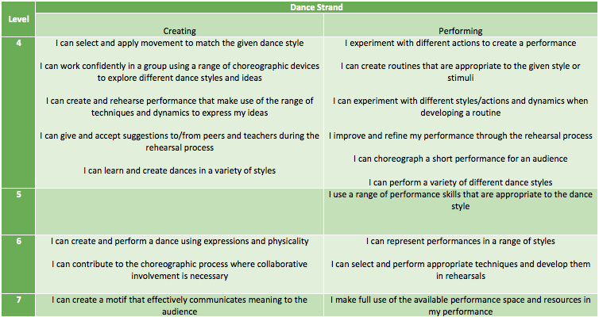
SUCCESS CRITERIA

Slide 6
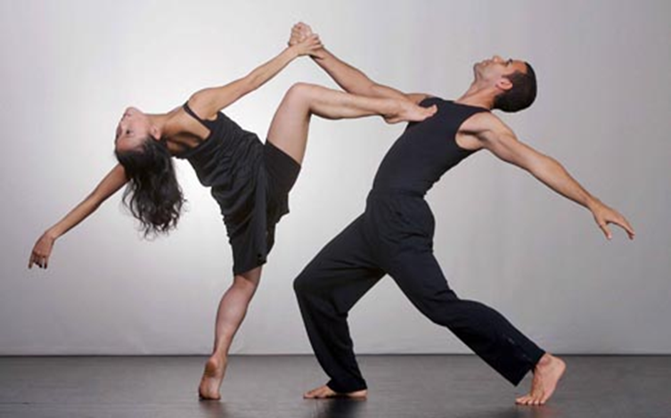
RECAP OF DANCE WARM UP

Slide 7
RECAP STREET DANCE ROUTINE

Slide 8
LEARN NEW SECTION OF STREET DANCE

Slide 9
PLENARY
CAN YOU REMEMBER THE KEY WORDS AND THE DEFINITIONS?
WHAT DO YOU FEEL YOU HAVE DONE WELL AT AND WHY.
WHAT DO YOU FEEL YOU NEED TO IMPORVE ON AND WHY?

Slide 10
KEY WORDS
WHAT ARE THE DEFINITIONS OF THE FOLLOWING WORDS?
MOVEMENT MEMORY
DYNAMICS
PATHWAYS
LEVELS
TRANSITION
MUSICALITY

